Slide 1

Bscs-2f
Group Member:
1.Crisostomo,Jose Enrique p.
2. FELIAS, JUDITH B.
3. PARANI, PIOLO
4. DAHIL ROCHELLE
5. GULTIA, SHERAMEH P.

Slide 2
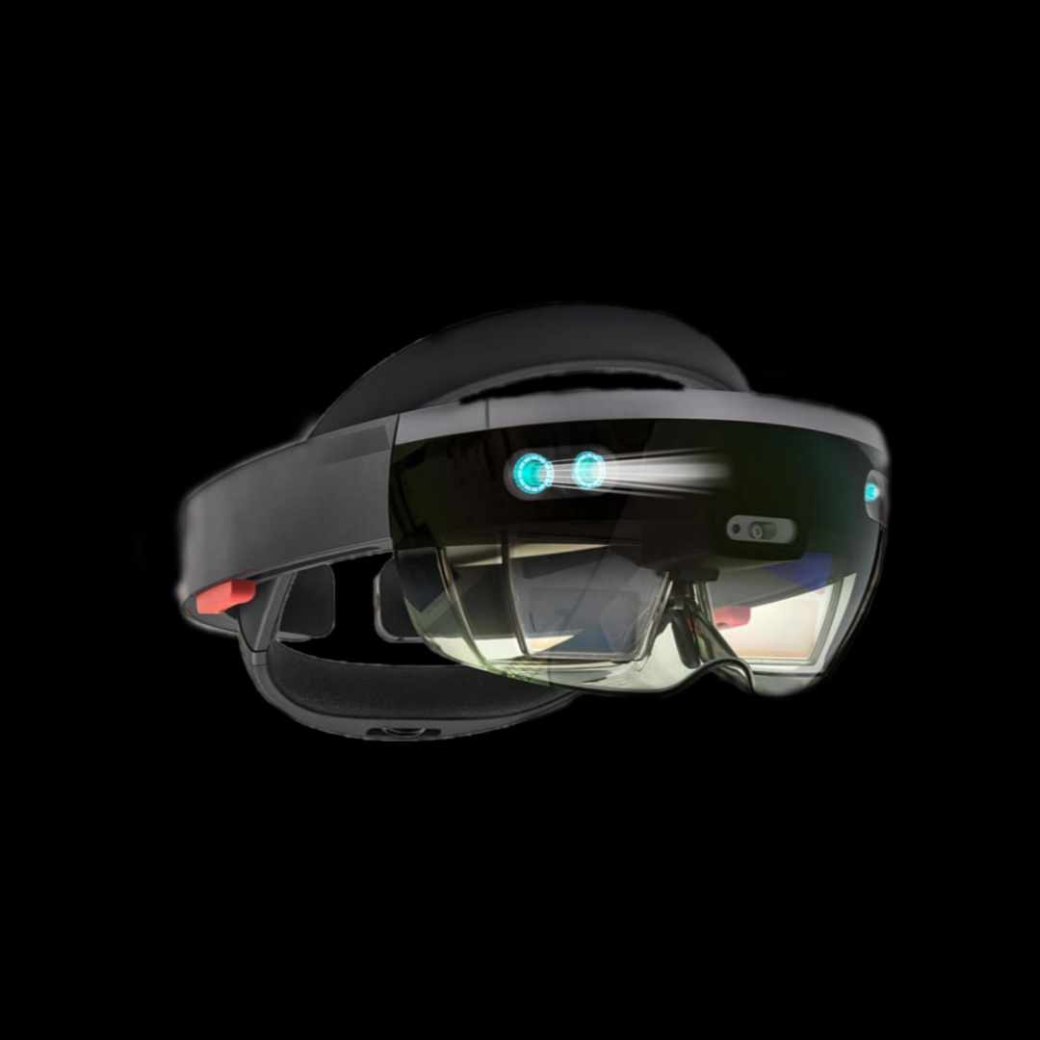
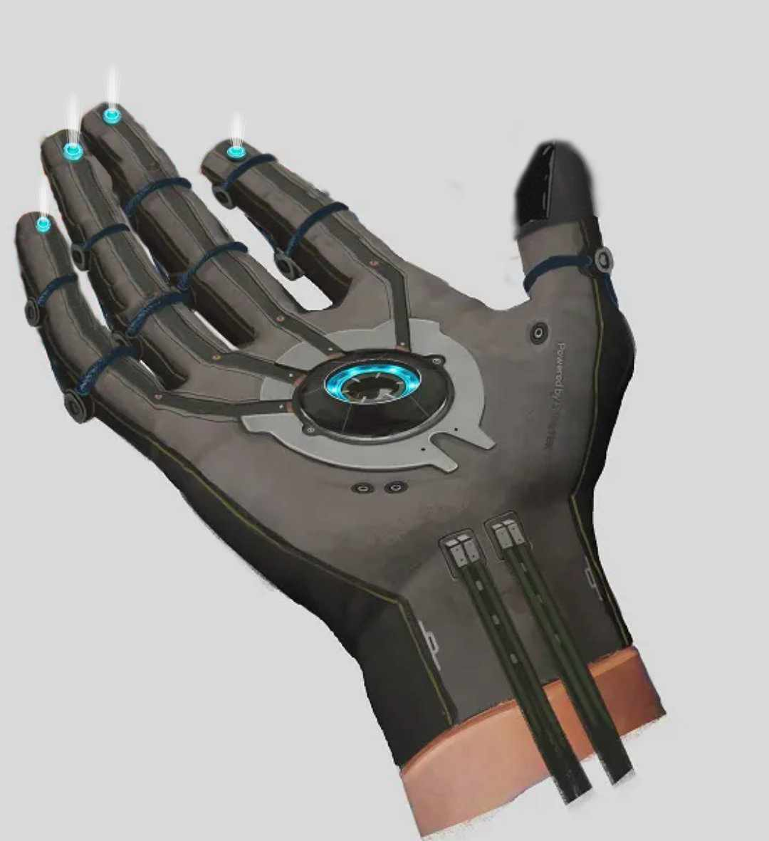
holographic virtual reality
DISABILITY HR GLOVES

Slide 3
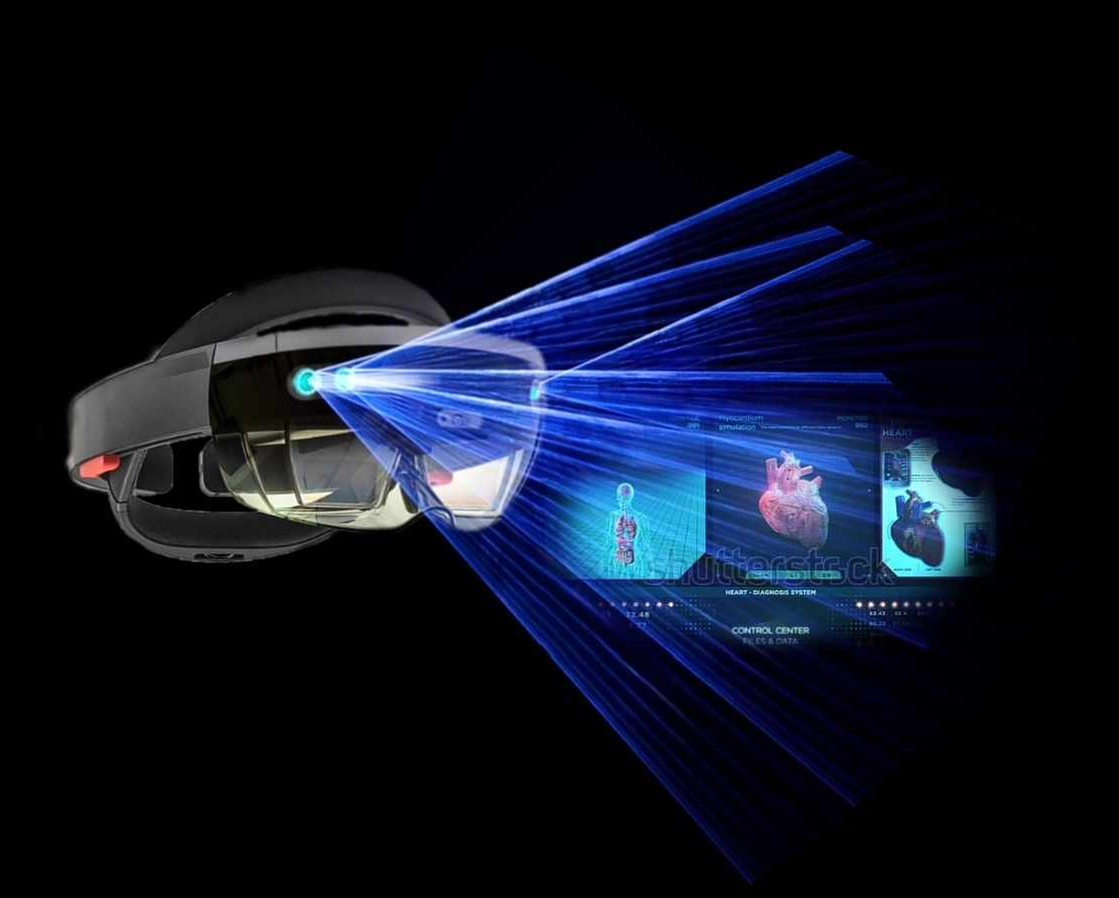
objective:
The objective of VR holograms is to enhance and enrich virtual reality experiences by incorporating realistic, three-dimensional holographic elements, improving immersion and interactivity for users.

Slide 4
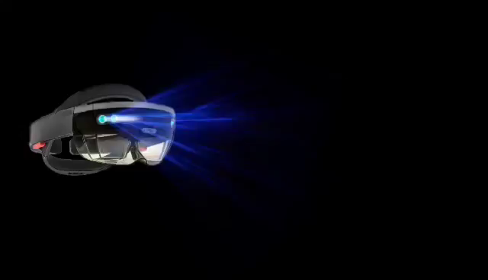
INTRODUCTION:
Virtual Reality Holograms, often referred to as VR Holograms, represent the exciting convergence of two transformative technologies. They enable immersive and interactive experiences where holographic objects seamlessly integrate into virtual reality environments, offering users an unparalleled sense of presence and engagement.
Purpose : VR holograms is to elevate virtual reality experiences by introducing lifelike 3D holographic elements, creating more immersive and interactive virtual worlds for users.

Slide 5
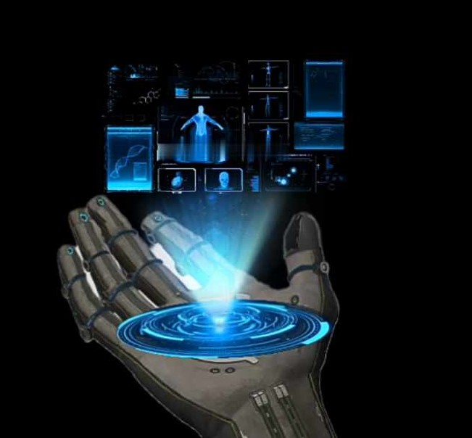
Objective:
The objective of a hologram displaying vital signs is to present health-related data in a three-dimensional format, providing a visual and easily interpretable representation of a person's essential physiological parameters for medical professionals and patients.

Slide 6
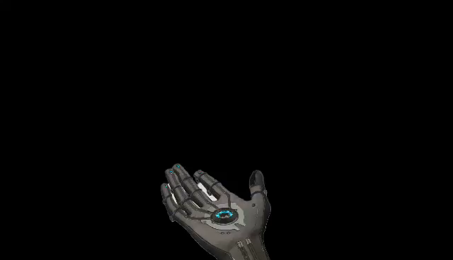
Introduction:
The purpose of a hologram displaying vital signs is to offer a visually intuitive and engaging way to monitor and comprehend crucial health metrics, promoting better health awareness and enabling quicker, more informed medical decisions.
"Imagine a future where your health data comes to life in stunning 3D. Welcome to the world of holographic vital signs, where your well-being is displayed in a whole new dimension."
Purpose : Imagine a future where your health data comes to life in stunning 3D. Welcome to the world of holographic vital signs, where your well-being is displayed in a whole new dimension."

Slide 7
Thank you for listening

